Slide 1


Read&Write
A literacy tool brought to you by the Academic Success Center

Slide 2
Background
Read&Write is a perfect fit for the Academic Success Center
  Independent tool for student success
  Supplements strategies already in place
  Can be used in Tutoring Sessions
  Accessibility features
  Testing Compatibility

Slide 3
Installation
Installation instructions can be found on the Read&Write page of the Richland website: www.richland.edu/readwrite
  Links to video installation instructions
  Installing on the Google Chrome browser is easiest, other options are available
  Video play lists for the different features
  Can use on multiple devices

Slide 4
Features
Features are similar across formats
Customize using the … for “more” and click on Options

Slide 5

Texthelp PDF Reader
Separate installation
  Texthelp PDF Reader Installation Video
  Once Read&Write is installed
    Go to: www.text.help/getpdf

Slide 6
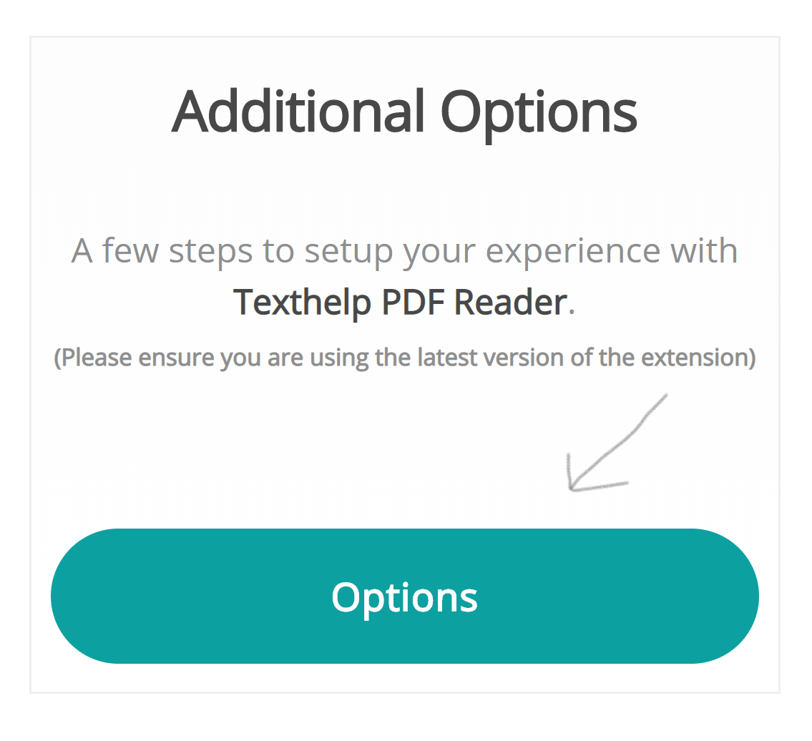
PDF Reader Installation
Once the Texthelp PDF Reader is installed, it should take you to the PDF Reader Dashboard page with an Additional Options button

Slide 7
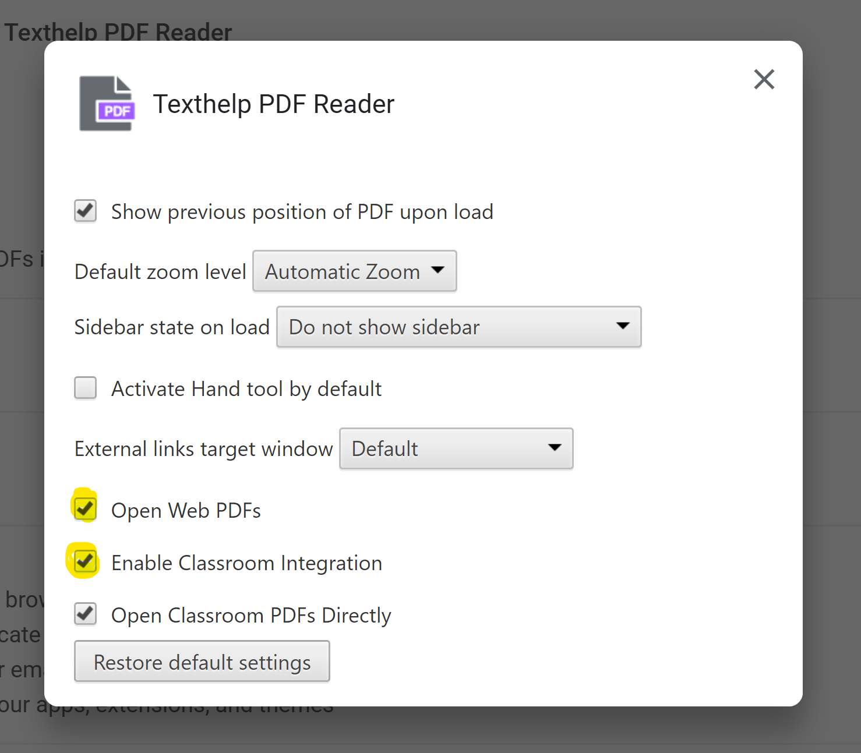
Enable PDF Reader
When this box pops up, click on the boxes next to Open Web PDFs and Enable Classroom Integration so that the checkmark appears
Click the “x” in the upper right corner of the pop-up box to close

Slide 8
PDF Extension Options
On the Extensions page for the Texthelp PDF Reader, scroll down until you see the option to “Allow access to file URLs” and make sure it is turned on (blue in color with the circle to the right)

Slide 9

Features grayed out?
You may need to update your browser or settings
  Troubleshooting support
Other issues or for more support, email asc@richland.edu
Additional extension for Screenshot reader may be required to use that feature. Installation instructions are similar to the PDF Reader and are initiated by clicking on the Screenshot Reader button in the Read&Write toolbar

Slide 10

Thank you!
Contact the Academic Success Center with any questions or for more information at asc@richland.edu

