Slide 1
Accommodations and Disability Services at Richland Community College
Tara Mata
Accommodations Specialist

Slide 2
Academic Success Center (ASC) W213
Accommodations
Mathematics Enrichment Center (MEC)
Tutoring (Richland Tutoring and NetTutor)
Testing Center
Study Skills and Academic Supports
Quiet place to study
Snacks and Coffee

Slide 3
Accommodations – who may be eligible?
Students who have been diagnosed with a disability and have functional limitations in the learning environment
IEP/504 Plan in High School
Anxiety, Depression, etc. if it rises to the level of disability and has at least one functional limitation in the educational setting
Temporary disability (broken arm, concussion, etc.)

Slide 4
Student Driven Process
Differences between high school and college
Focus on Access in the college setting
Confidentiality
Role of parents/guardians
If under 18, parent/guardian must sign consent and attend accommodations appointment
Disability Rights
Americans with Disabilities Act (ADA)
Section 504 of the Rehabilitation Act of 1973
Self-Advocacy and Ownership
Do I really need to apply for accommodations?

Slide 5
Accommodations – 3 Easy Steps
STEP 1 - Apply for Accommodations
STEP 2 - Provide Documentation of Disability
STEP 3 - Participate in an Interactive Accommodations Appointment
*To obtain an application or other materials in an alternate or accessible format, please email accom@richland.edu

Slide 6
Log in to myRichland
Follow the link to myRichland from the Richland website or go to https://jics.richland.edu/ICS/
If you have already activated your account, log in using your Richland NetID Username and Password
If you have not yet activated your account, follow the instructions on the login screen (instructions on next slide)

Slide 7
myRichland Account Activation
I need help logging in & I am a currently enrolled student (or employee)
Choose either the login text above (mobile view) or enter your credentials in the username and password fields.
Students who are currently registered for classes should use their Richland NetID username and password to log into all RCC systems (myRichland, Canvas, email, library databases, etc.)
If you are currently registered for classes and do not have a Richland NetID, you need to activate your account.
If you are currently registered for classes and have forgotten your password, click here to reset your password.
If these methods do not work, contact ochelp@richland.edu for assistance.
I need help logging in & I am *not* enrolled
If you have been a student within the last year, try logging on with your NetID and password.
If your NetID and password do not work (or you haven't been enrolled in classes during the past year) enter your Student ID number in the User Name box and birthdate (in MMDDYY format) in the Password box to log in to myRichland.
Contact ochelp@richland.edu if you need assistance.

Slide 8
Placement Test Accommodations
Placement tests are already untimed and able to be taken in a quiet location. If additional accommodations are requested (i.e., Test Reader, Test Writer), the accommodations process will need to be completed before taking required Placement Tests.
If additional accommodations are not needed for Placement Tests or Placement Tests are not required, you can wait until you are registered for classes to apply for accommodations.

Slide 9
STEP 1 - Apply for Accommodations online at my.richland.edu
Click on or hover over My Student Info and select Accommodations.
Review consent information and update if needed; click on “Save Consent.”
Select the term that you are applying for and click on “Go to the online Accommodation Application.”
Complete the application and submit.

Slide 10
Consent
Completing the Consent is required and can be viewed or updated at any time
Optional Consent Boxes
Other Consent
Parent/Guardian consent is required if under 18

Slide 11
Application
Select the term you are applying for
Click the link to Go to the online Accommodations Application
Complete the application and submit
Email confirmation sent

Slide 12
STEP 2 - Submit Documentation
Provide documentation of disability to the Academic Success Center via email to accom@richland.edu or via fax to 1-217-875-6961
Documentation guidelines can be found on the Accommodations page of Richland’s Website and on myRichland and on the following slides
Richland accepts submissions of current IEP or 504 Transition plans (typically the senior year report)
Make sure you keep a copy of all of your documentation for your records and any future needs

Slide 13
How to Document a Physical or Psychological Disability
Please submit a current statement on letterhead that is signed, dated, clearly states the evaluator’s credentials, and includes the following:
Diagnosis – Medical diagnosis or DSM-V diagnosis
Functional Limitations – Explain how the disability substantially limits a major life activity. What difficulties will the student have at the Community College as a direct result of the diagnosis?
Recommendations – Provide a list of recommendations for the academic environment based on the student’s functional limitations.
Psychological disabilities may be documented by psychologists, psychiatrists, licensed clinical social workers, and licensed clinical professional counselors.
Physical disabilities may be documented by medical doctors/specialists.

Slide 14
How to Document a Learning Disability
Please submit a current statement by certified/licensed psychologist, psychiatrist, or neuropsychologist on letterhead that is signed, dated, clearly states the evaluator’s credentials, and includes the following:
Diagnosis - Statement confirming that the student has a specific Learning Disability.
Functional Limitations - Explain the substantial limitations that the disability will have on the student’s learning.
Recommendations- Provide a list of recommendations for the academic environment based on the student’s functional limitations.
Acceptable Assessments-
Psychological Evaluation, Neuropsychological Evaluation, Psycho-educational Evaluation, Learning Disability Assessment, Transition IEP
Psychometric tests should include Adult normed intelligence testing (WAIS III) and Achievement and information processing (Woodcock-Johnson, Stanford-Binet)
WISC

Slide 15
STEP 3 – Meet with Accommodations Specialist
Once the review of the application and documentation is complete, the Academic Success Center will contact you to schedule an appointment. Virtual appointments will be available during the COVID-19 pandemic. During this appointment, appropriate accommodations are determined in an interactive process utilizing the documentation provided.

Slide 16
Interactive Interview
The interactive interview is an opportunity to create a collaborative accommodations plan based on documentation and self-report
The information you share about your disability is confidential
You may be asked about your educational goals, learning styles and preferences, study skills and habits, any accommodations you have had in the past, what works best for you, how your disability impacts learning and studying, types of resources and technology you are familiar with, or other similar questions.

Slide 17
Accommodation Notices
Sent via email to instructors with confirmation email to student
Does not divulge disability, only lists approved accommodations
Student email includes copy of Student Responsibility Form as attachment
Self-Advocacy Behaviors of Successful College Students
Student Rights and Responsibilities

Slide 18
Reapply for Accommodations Each Semester After Registering for Classes
Follow the same steps to apply for accommodations, selecting the correct term from the drop down list (circled on screenshot) and click on the link to Go to the online Accommodation Application
If applying for same accommodations, only need to answer a few questions
If applying for updated accommodations, add information about request

Slide 19
Using Accommodations
Communicate with your instructor about how your use of accommodations will look in their class
Which accommodations you plan to use
How the accommodations will be implemented for the class
May not use some approved accommodations for some classes
Use of accommodations is optional but highly recommended
Read the syllabus and ask questions to anticipate additional accommodations needs

Slide 20
Additional Information
Additional information regarding accommodations can be found on the Accommodations page of Richland’s website and the accompanying Frequently Asked Questions for Accommodations page.

Slide 21
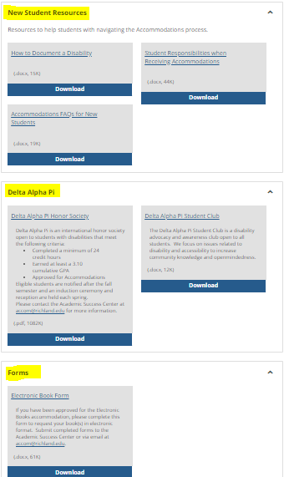
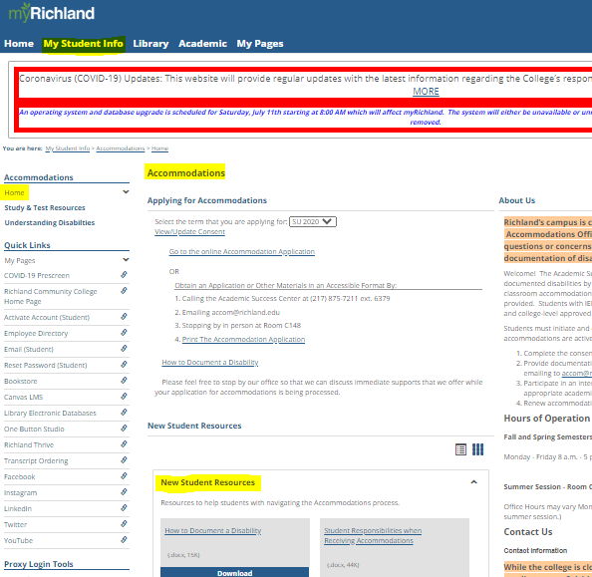
myRichland Resources
Scroll down on the Accommodations Home page on myRichland under the My Student Info Tab to find helpful resources
Scroll down even further to find more Student Resources

Slide 22
College and Career Competencies
Free summer program for students with accommodations transitioning from high school to college (held in fall for 2020)
Topics include:
Self-Advocacy and Communication
Study Skills and Time Management
Habits of Successful College Students
Utilizing Resources
To sign up or learn more, contact us via email at accom@richland.edu. Space is limited.

Slide 23
LASSI and Study Skills
Take the Learning and Study Strategies Inventory (LASSI) for free and identify areas to improve your study skills and strategies!
The LASSI groups the results into 10 Scales to determine areas of need.
Canvas course with resources compiled by Scale into Modules: link can be found on the Accommodations page of myRichland under the My Student Info tab.
Contact the ASC by emailing accom@richland.edu or tmata@richland.edu to schedule an appointment to take the LASSI.

Slide 24
Delta Alpha Pi
Delta Alpha Pi is a student club with two separate components:
An international honor society for students with disabilities meeting the minimum qualifications of 24 credit hours and a GPA of 3.10. An induction ceremony for new members is held each spring and is open to all faculty, staff, students, and previously inducted members
A disability advocacy and awareness club open to all students

Slide 25
Campus Involvement
Clubs
Intramural Sports
Study Groups
Recreation
Student Engagement Events
Plenty of opportunities to become involved! Not any clubs you are interested in? Start your own! See Student Engagement for details about starting a club.

Slide 26
One Button Studio
Make and save high-quality and polished video projects ready to be captioned using Studio in Canvas
Create a professional video presentation
Record innovative videos for class projects
Record a lecture or demonstration
Practice presentations
Prepare for a job interview
Other? Let’s dream big!
W139 in the Library – Check in myRichland Resources for more information

Slide 27
Tutoring
Tutoring is free and available for all students and is not part of an accommodation plan
Tutors do not receive a copy of the accommodation plan, please inform the tutor and/or Accommodations Specialist if you will need an accommodation during the tutoring session (i.e., Sign Language Interpreter, magnification, seating style or arrangement)
Remote Richland Tutoring and NetTutor can both be accessed in the left-hand menu once you log into your Canvas Course
Email tutoring@richland.edu for any questions about tutoring

Slide 28
Online Instructional Delivery
Requires good Time Management and Organizational skills
Minimize distractions
Log in regularly
Communication is key
Break down tasks into clear, manageable steps
Use available resources
Instructors office hours
Tutoring
Technology (apps, virtual study groups, etc.)

Slide 29
Time Management
Planner and/or Calendar
Organization
Power Study Hour
Pomodoro Technique
Create a Study Plan

Slide 30
Effective Study Area and Environment
Ideal Study Environment
Music
Distractions
Lighting
Posture
Sleep and Healthy Habits
Technology

Slide 31
Check Richland Emails Regularly
Accommodations Notices and other important emails are sent to Richland email accounts. It is important to check Richland email regularly
Consider connecting your Student Email to your phone or other device
Instructions can be found on the Tech Services page in myRichland under the My Student Info tab and on the next slides

Slide 32
Connecting Student Email to Apple Device
Add Office 365 Student Email to Your iPhone or iPad
Open your Settings app
Tap on Passwords & Accounts
Tap on Add Account
Select Exchange / ActiveSync (whichever is listed on your device)
Enter your Richland email address & tap Next
When asked if you want to sign in to your "richland.edu" account, click on Sign In
Enter your Richland NetID password and click on the Sign In button
Click on the Save button to finish adding your account

Slide 33
Connecting Student Email to Android Device
Adding Office 365 Student Email to your Android Device
Open your Settings
Open your Accounts
Tap on the Add Account button
Select the Microsoft Exchange / Active Sync / Corporate (whichever is listed on your device)
Enter your Richland email address
Enter your Richland NetID password
Click on the Sign In button
Click on the Next/Done button to finish adding your account

Slide 34
Please Ask Questions and Seek Support
Academic Success Center – Accommodations
Accommodations general: accom@richland.edu
Tara Mata, Accommodations Specialist: tmata@richland.edu
Annetta Evans, ASC Administrative Assistant: aevans@richland.edu
Dr. Leanne Brooks, ASC Director: lbrooks@richland.edu
Once the Academic Success Center reopens:
(217) 875-7211 x6379
W213

Slide 35
Thank You!

