Slide 1
Richland Community College
Adjunct Instructor
Orientation

Slide 2
Emergency Procedures
Campus Security = x6555
911
Behavioral Threat Assessment Team
Accident Reporting
Inclement Weather

Slide 3
Preventing Harassment
Commitment
Respect
Excellence
Accountability
Diversity

Slide 4
Select Policies
Equal Employment and
Non-discrimination
Anti-harassment
Family Educational Rights and Privacy Act
Information Technology Use

Slide 5
Pay
Calculated on an Equated Credit Hour basis
i.e. $612 * 3 ech.
Direct Deposit available
Frequency = 2x month

Slide 6
Benefits
Fitness Center
Absences
1 per class per semester
advance notice if possible
Adjunct Recognition
Tuition Waiver
w/ one semester of service

Slide 7
Required Training
Ethics on-line Training
Mandatory Reporter Training

Slide 8
Richland Community College
HR
Resources…

Slide 9
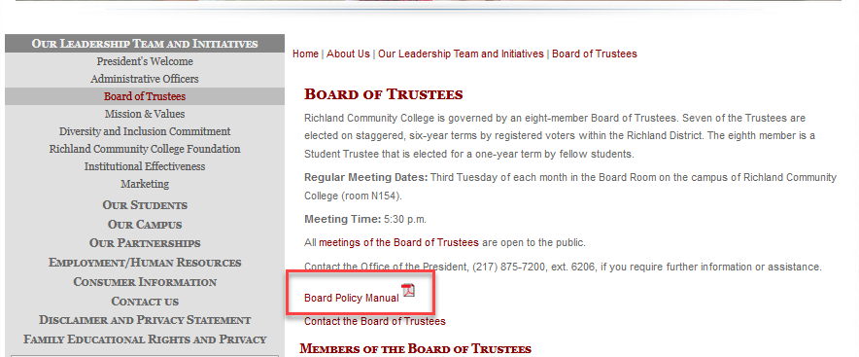
Board Policy Manual
www.richland.edu/board

Slide 10
Board of Trustees Policy Manual
Hiring rules
Pay Policies
Harassment-Free Workplace
Leave and Time off Policies
Many other employment-related policies

